Slide 1
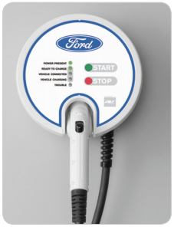

ford CHARGING Station Customer requirements
EDU Project
karacankos@gmail.com
https://www.linkedin.com/in/omer-karacan/
https://www.instagram.com/karacanos/

Slide 2
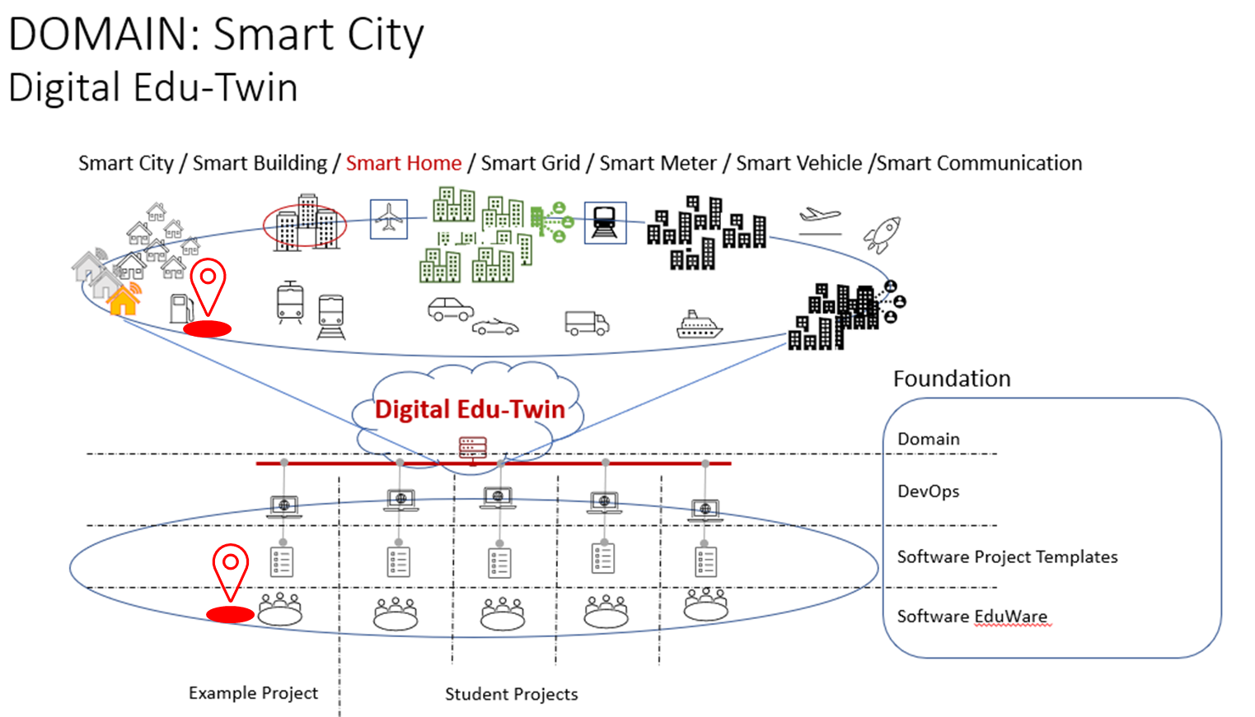

Project Context

Slide 3

PROJECT FORDCS V1.0 customer requirements documentation
<project>
Customer Requirements Document
FORDCS
Customer Requirements Document

Slide 4
FORDCS V1.0 – Customer Story
Customer wants a demonstration how a given FORD Charging Station (FORDCS) interacts with the person who wants to charge his/her car!.
The interaction should be based on an educationally simulated FORDCS, that is,
The behavior of the FORDCS should be defined by a state machine which is based on the status LEDs and their description given in a picture of the FORDCS Data Sheet (https://www.evsolutions.com/Upload/Product/635652466512570000.pdf)
The human-machine interaction (User Interface) should be based on
the status LEDs given in a picture, and
the technical characteristics given in a table of the FORDCS Data Sheet (https://www.evsolutions.com/Upload/Product/635652466512570000.pdf)

Slide 5
FORDCS V1.0 – Customer Requirements
The FORDCS customer requirements comprises
the FORDCS Data Sheet (PRIMARY SOURCE), and
The illustrations, models, and explanations in this presentation document (SECONDARY SOURCE), and
The human-machine interface defined by Swagger RESTful web services (TRINITY SOURCE)!
Project : https://app.swaggerhub.com/apis/karacankos/fordcs/1.0-oas3
Swager document : https://app.swaggerhub.com/apis-docs/karacankos/fordcs/1.0-oas3
Shared : https://app.swaggerhub.com/apis/karacankos/fordcs/1.0-oas3
The requirement gaps (issues) are resolved with intellectual assumptions and should be explained in this document!

Slide 6








FORDCS V1.0 –Customer Requirements Artifacts
<project>
Customer Requirements Document
<project>
Test Code
FORDCS
Customer Requirements Document
FORDCS
Project Setup
ford-charging-station-customer-needs.v2022.03-1.pptx (this document, slides #3 - #9)
EDUp FORDCS V1.0 PROJECT SETUP-v2022.04.docx
Artifacts should be created according to “EDUp-Full-Stack-Software-Project-Development-Method”
<project>
System Requirements Specification
<project>
Architecture Design Specification
<project>
Component Code
FORDCS
System Requirements Specification
FORDCS
Architecture Design Specification
FORDCS
Component Code
DevOps Document
FORDCS
DevOps Document
<project>
Validation Test Specification
<project>
Validation Test Specification
<project>
Test Code
FORDCS
Validation Test Specification
FORDCS
Verification Test Specification
FORDCS
Test Code
Incl. designed swagger-ui
Incl. generated swagger-ui

Slide 7


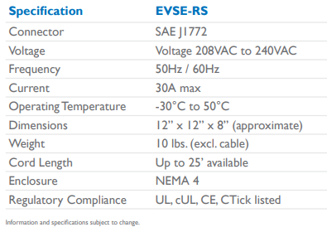


FORD Charging station V1.0 Device characteristics SYSTEM Black-BOX
Use Case
Report Factory Setting V1.0
Domain Model
Web Service
guest
service

Slide 8

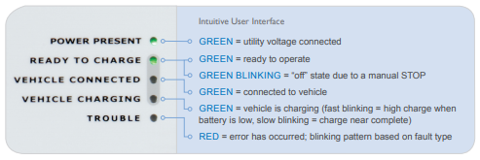


FORD Charging station V1.0 SYSTEM BEHAVIOR SYSTEM Black-BOX
Web Service
Use Case
Run-time Status Report V1.0
UX
guest
Use Case
Monitor and Control Run-time Status V1.0
V1.0
W/O LED COLOR STATUS
V1.0 does not consider the LED’s color-based charging status information.
service

Slide 9
V1.0 SYSTEM Behavior (W/o LED STATUS) SYSTEM WHITE-BOX
V1.0 Model version: 2022.03
e: power_on
t: power_on
Events:
Power_on
Ready_to_charge
Vehicle_disconnected
Start_charging
Stop_charging
Vehicle_connected
Failure
Power_off
POWER OFF
e: ready_to_charge
t: ready_to_charge
e: power_off
t: power_off
e: vehicle_disconnected
t: ready_to_charge
power present
ready to charge
INITIAL_STATE
e: vehicle_connected
t: vehicle_connected
vehicle connected
e: failure_fixed
t: ready_to_charge
States:
INITIAL_STATE
POWER_OFF
UX_POWER_PRESENT
UX_ READY_TO_CHARGE
UX_ VEHICLE_CONNECTED
UX_ VEHICLE_CHARGING
UX_ TROUBLE
e: failure
t: failure
e: stop_charging
t: vehicle_connected
trouble
vehicle charging
e: start_charging
t: start_charging

Slide 10
PROJECT FORDCS V2.0

Slide 11

FORD Charging station V2.0 SYSTEM Behavior SYSTEM Black-BOX
Web Service
Use Case
Run-time Status Report V2.0
UX
guest
Use Case
Monitor and Control Run-time Status V2.0
V2.0
CONSIDERING LED STATUS
GREEN_BLINKING (manuel stop)
VEHICLE_CHARGING GREEN STATUS LED
FAST BLINKING, SLOW BLINKING
TROUBLE RED STATUS LED
PERMENANT, FAST BLINKING, SLOW BLINKING
service
Use Case
Run-time Failure V2.0
incident

Slide 12
SYSTEM Behavior V2.0 (W/ RED & GREEN STATUS) SYSTEM WHITE-BOX
Events:
Power_on
Ready_to_charge
Ready_to_charge_manuel_stop
Vehicle_disconnected
Start_charging
Stop_charging
Vehicle_connected
Failure_fixed
Failure_internal
Failure_data
Failure_hw
Power_off
V2.0 Model version: 2022.01
ready to charge stopped
e: power_on
t: power_on
e: ready_to_charge_manuel_stop
t: ready_to_charge_stop
e: ready_to_charge
t: ready_to_charge
POWER OFF
e: ready_to_charge
t: ready_to_charge
e: power_off
t: power_off
power present
ready to charge
e: failure_fixed
t: power_on
e: vehicle_disconnected
t: ready_to_charge
States:
INITIAL_STATE
POWER_OFF
UX_ POWER_PRESENT
UX_ READY_TO_CHARGE
READY_TO_CHARGE_STOPPED
UX_ VEHICLE_CONNECTED
UX_ VEHICLE_CHARGING
UX_ TROUBLE
INITIAL_STATE
e: vehicle_connected
t: vehicle_connected
e: failure_fixed
t: ready_to_charge
vehicle connected
trouble
e: stop_charging
t: vehicle_connected
e: failure_internal, failure_data, failure_hw
t: failure
e: start_charging
t: start_charging
vehicle charging

Slide 13
BACKYARD
Wichtige Informationen

Slide 14
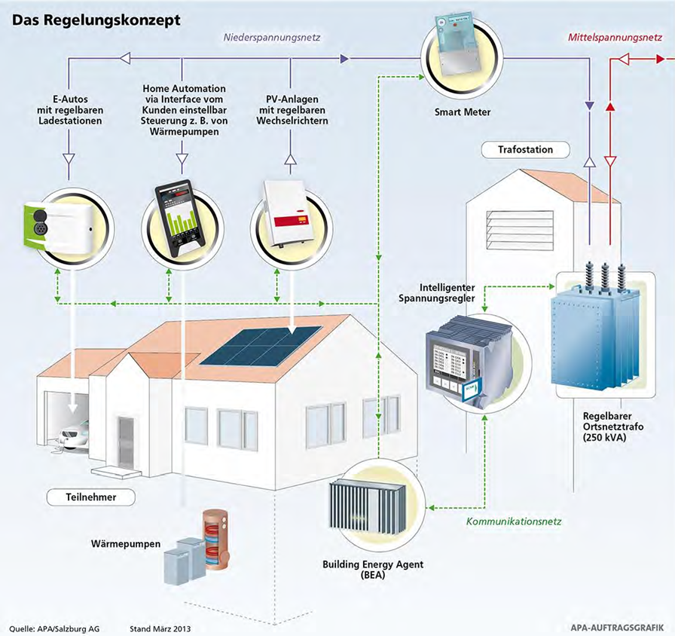
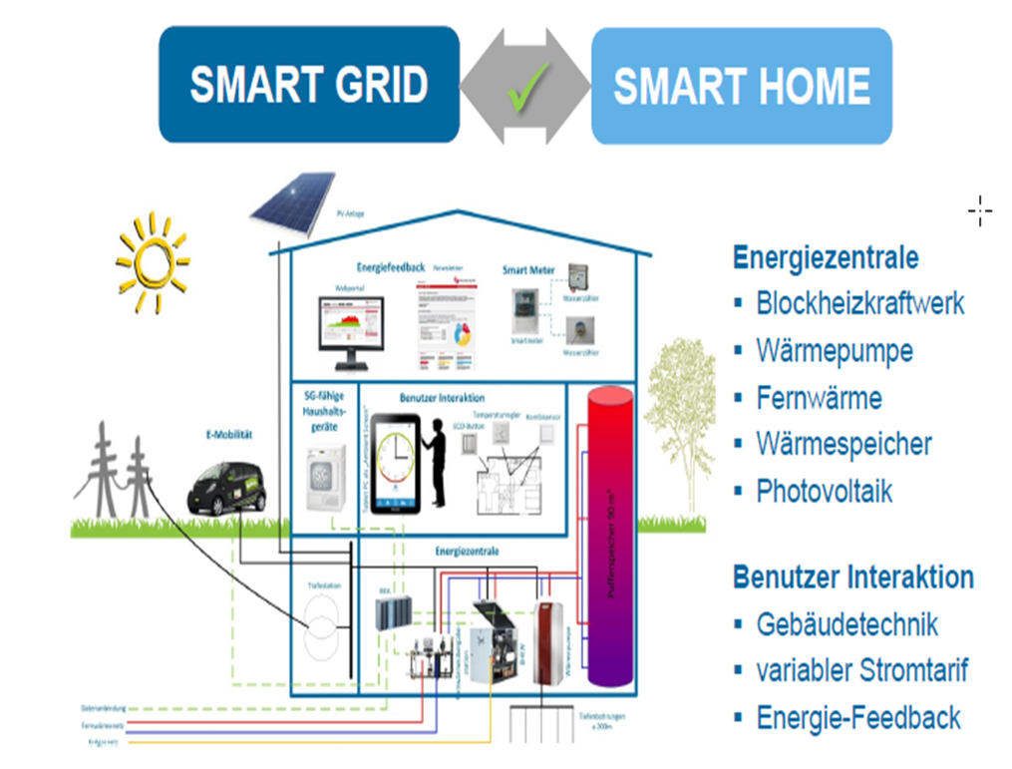
FORCS KONTEXT – SMART HOME
Charging Station

Slide 15
Notes
FORD – Charging Station
https://www.evsolutions.com/Upload/Product/635652466512570000.pdf

